Slide 1
moviz
Data Visualization project
Adib Menchali
Simone De Benedictis
Theo Ramond

Slide 2
Table of contents
01
02
03
04
The Data
The Visualizations
The Moviz app
The Web Page

Slide 3
01
The Data

Slide 4


Generating the dataset
Extracting data from the TMDb API.
Title: The title of the movie.
Genre: The genre of the movie.
Year: The year the movie was released.
Rating: The rating of the movie.
Director: The director of the movie.
Cast: The cast members of the movie.
Duration: The duration of the movie in minutes.
Language: The main language of the movie.
Country Of Origin: The country where the movie was produced.
Revenue: The total revenue generated by the movie in USD.
Budget: The total budget for making the movie in USD.

Slide 5
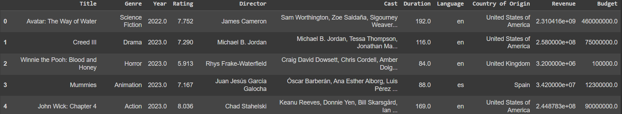
A glance at the data
Shape: 11 Columns and 1000 rows
Dropped null values.
No Duplicates.
Dropped Revenue and Budget after graphing them since they mostly contain missing values.

Slide 6


The Visualizations

Slide 7
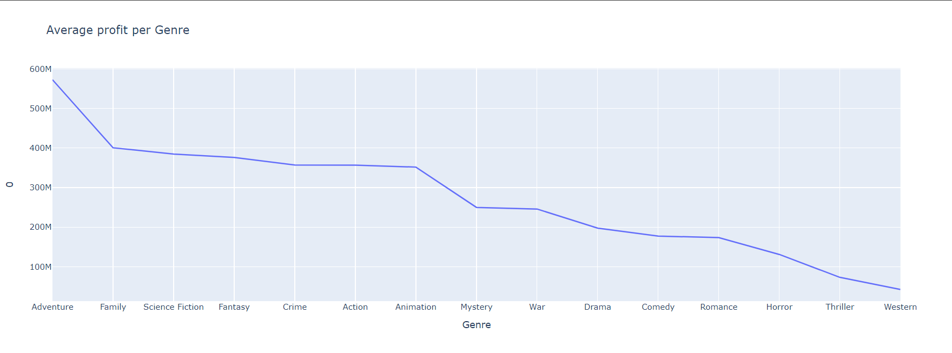
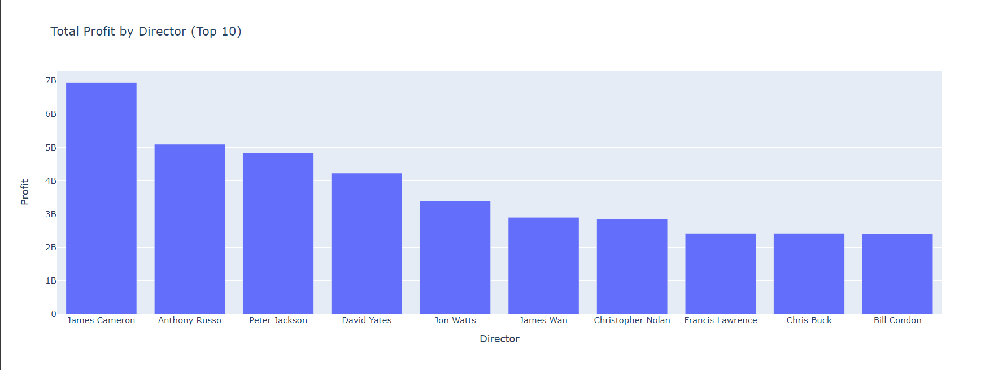
Profitability Graphs
Findings:
Adventure is the most profitable genre followed by Family and Sci-Fi movies.
Findings:
James Cameron is the most profitable Director in our dataset

Slide 8
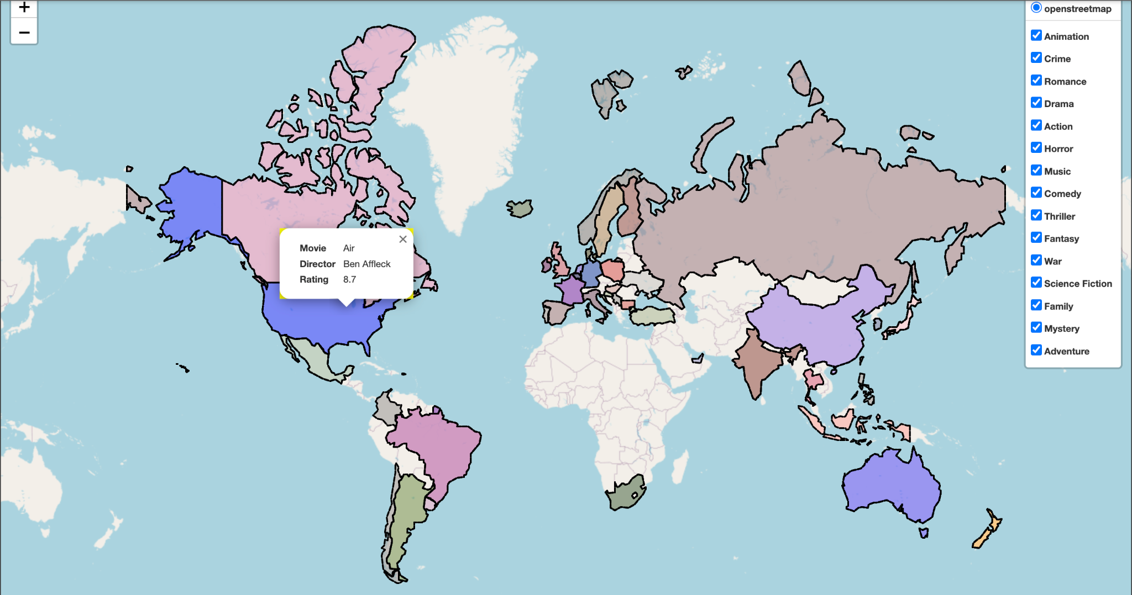
Highest rated movies per country
Purpose:
Visualizing the highest rated movies by Genre and Country.
*Color coded by Genre.

Slide 9
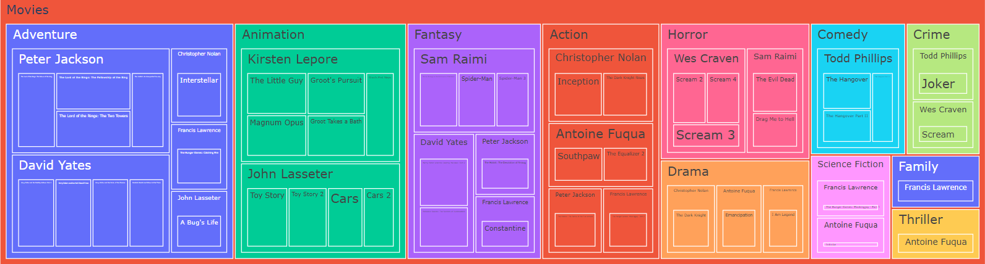
Connections between Genres and Directors
*Color coded by Genre
Purpose:
Visualize the Genre focus for top directors.
Some directors often show up in different Genres.

Slide 10
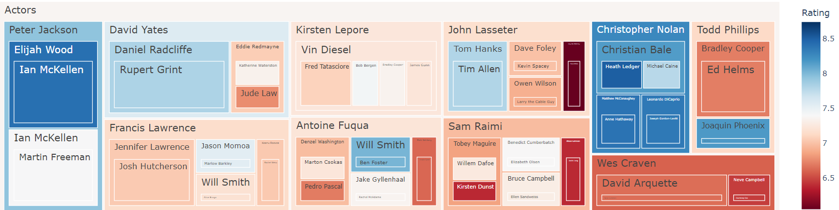
Connections between Directors and Actors
Purpose:
Visualize the connections between Directors and Actors
The map is color coded based on Rating.

Slide 11
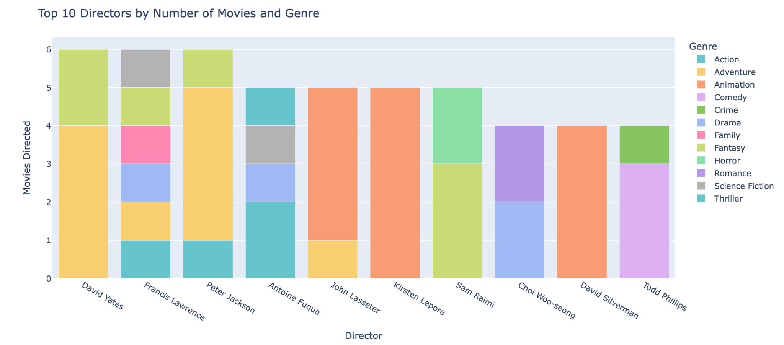
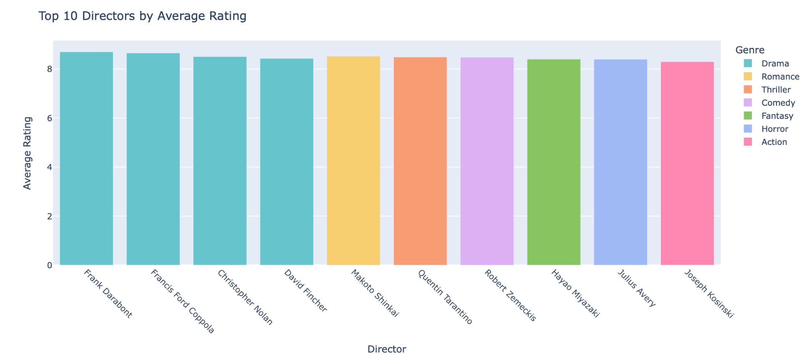
Top 10 Directors by Movies, Genre and Rating

Slide 12
The Moviz App

Slide 13
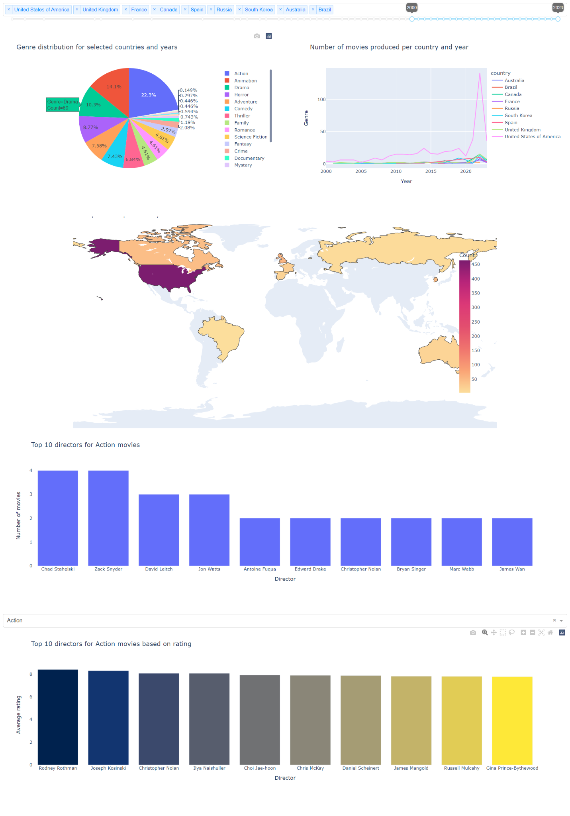
The Moviz App: Full interactivity
The slider (for the years) and the dropdown list (for the countries) can both be adjusted to change the visualizations accordingly.
Clicking on genres and countries filters all the visualizations.

Slide 14
The Moviz App
The bar charts are updated in real-time by adjusting the slider, the countries, and the genre of the movies.

Slide 15
The Web Page

Slide 16

The Web Page: Demo

Slide 17
The Moviz App: Demo

Slide 18
Thank you!

